Slide 1
Predicting NOx Concentration Level in Air
Malathi M
PGDM in Business Analytics,
REVA University, Bengaluru
May 2019
Forecasting NOx Levels

Slide 2
Agenda
Problem Understanding
Data Gathering & Understanding
Data Preparation
Modelling
Interpretation
May 2019
Predicting NOx Levels

Slide 3
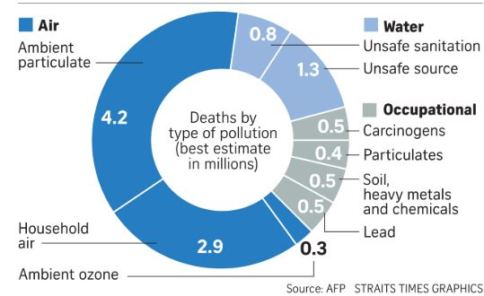
Problem Understanding:
Overview on Air Pollution :
Air Pollution is one of the major environmental issues and becoming major health problem that are effecting millions of people worldwide. Exposure to pollutants for a long time can lead to premature deaths, asthma, lung cancer, heart attack.
Death by Contamination(as Reported by THE STRAITSTIMES)
May 2019
Predicting NOx Levels

Slide 4
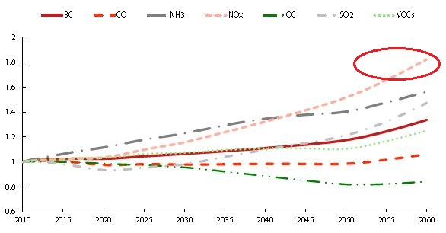
Problem Understanding (Continued):
Impact of Air Pollution on economy:
As per OECD impact of outdoor pollution are projected to lead to global economic cost that gradually increase to 1% of global GDP by 2060
A World Bank Study shows that welfare costs and lost labour income due to air pollution amounted to 8.5% of India’s GDP in 2013
Emission Projection over time (as Reported by OECD)
Problem Statement
To identify the pattern NOx of levels in air and building a predictive model to predict concentration levels of
NOx (Oxides of Nitrogen) and to know NOx levels are within AQI Index.
May 2019
Predicting NOx Levels

Slide 5
Data Gathering:
Data Description:
Data Source : Central Pollution Control Board of India
Time Period : February 2009 to September 2018
Method : 4 hour Sampling
Location and shape of the data
Description of the variables
Location | Shape of the data
Kadubeesanahalli | 21126 observations & 9 variables
Peenya | 21360 observations & 6 variables
BTM Layout | 21006 observations & 9 variables
Variable | Variable Type | Unit of Measurement
NOx (Oxide of Nitrogen) | Pollutant | µg/m3
WS(Wind Speed) | Meteorological factor | m/s
WD(Wind Direction) | Meteorological factor | Degrees
VWS(Vertical Wind Speed | Meteorological factor | m/s
BP(Bar Pressure) | Meteorological factor | mmHg
Temp(Temperature) | Meteorological factor | Degree centigrade
RH(Relative Humidity) | Meteorological factor | Percentage
SR(Solar Radiation) | Meteorological factor | W/m2
May 2019
Predicting NOx Levels

Slide 6
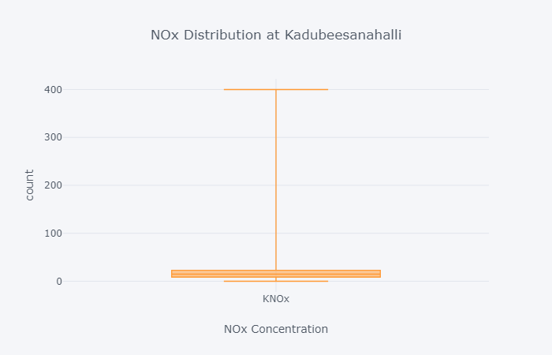
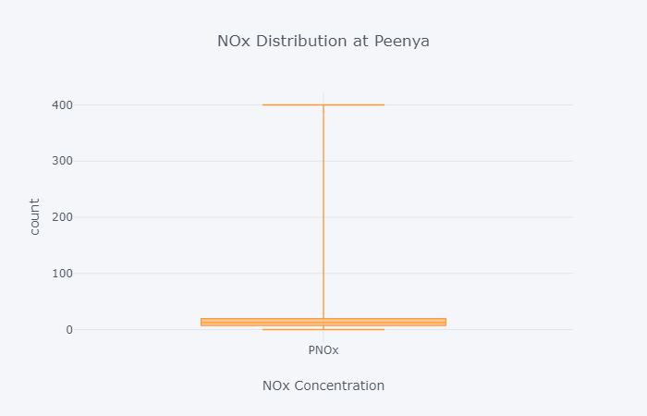
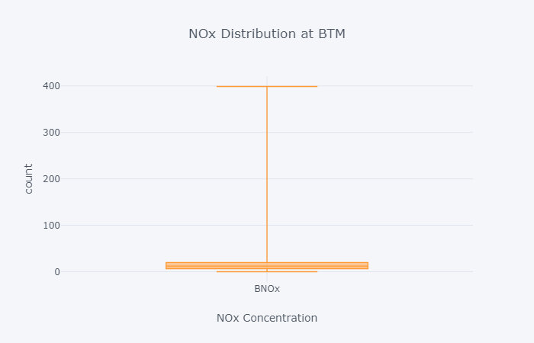
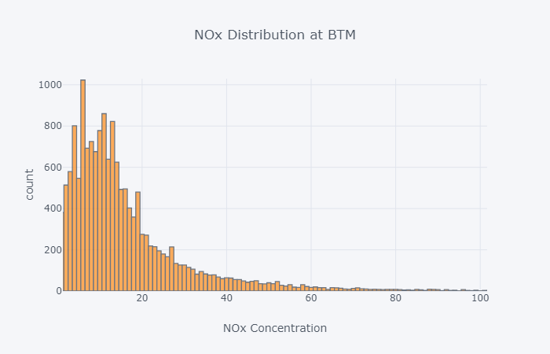
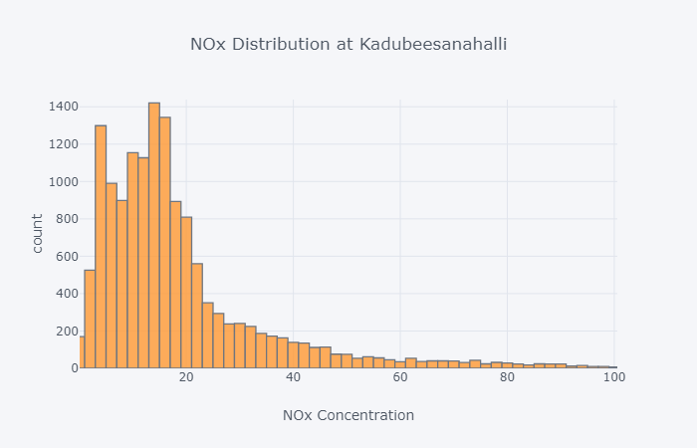
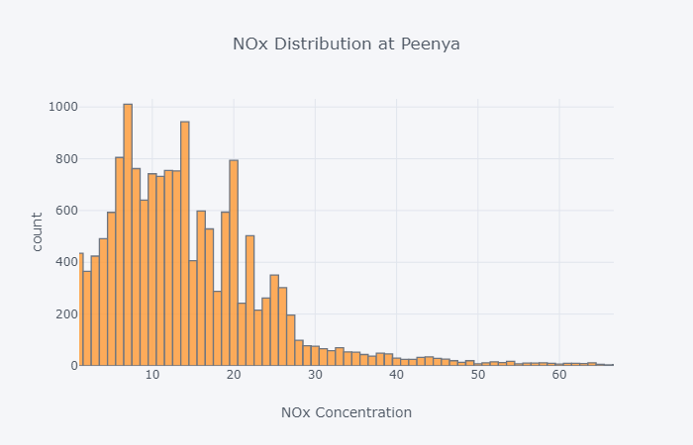
Data Understanding:
Distribution NOx at three locations :
Most of the time since ten years the Nox levels are within the range of the AQI
May 2019
Predicting NOx Levels

Slide 7
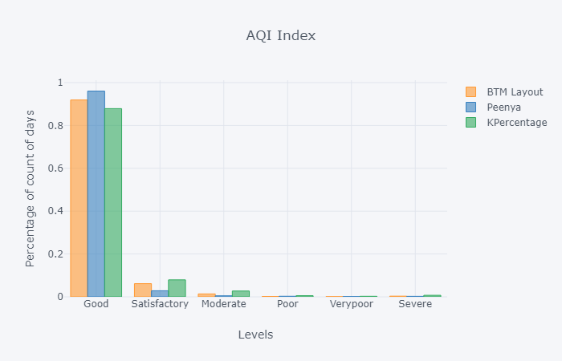
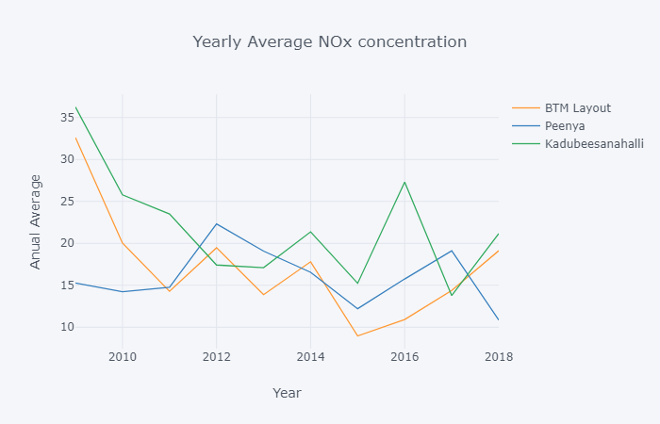
Data Understanding(continued):
Yearly average concentration levels at the three places
Classification of Concentrations levels as per AQI Index at three places
May 2019
Predicting NOx Levels

Slide 8
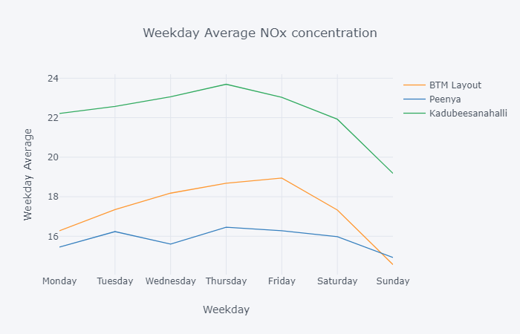
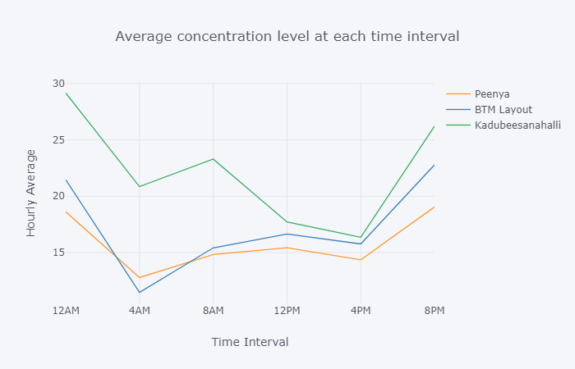
Data Understanding(continued):
Hourly average concentration levels at every four hour time interval
Average concentration levels over weekdays
May 2019
Predicting NOx Levels

Slide 9
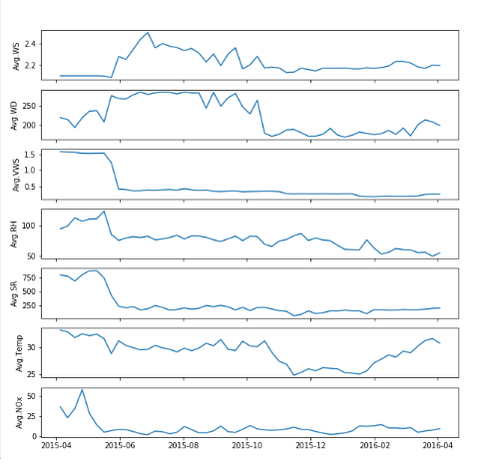
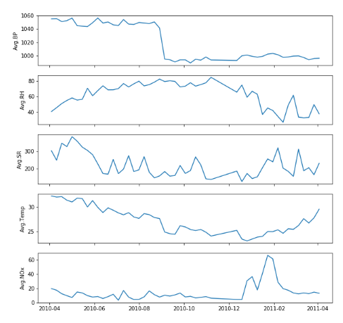
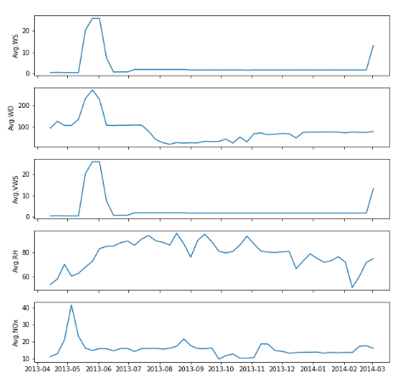
Data Understanding(continued):
Seasonal Trend:
Peenya
Kadubeesanahalli
BTM
May 2019
Predicting NOx Levels

Slide 10
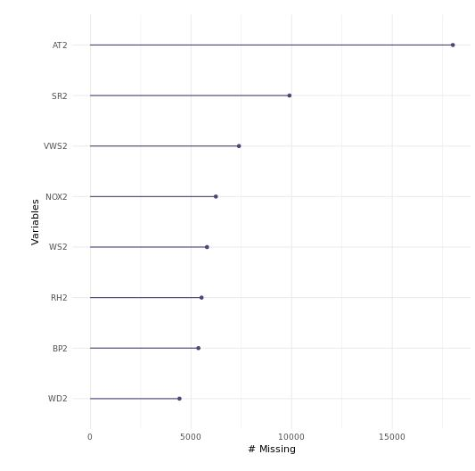
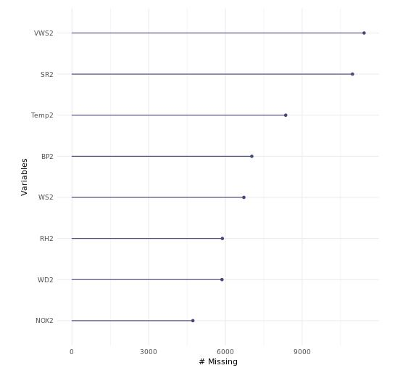
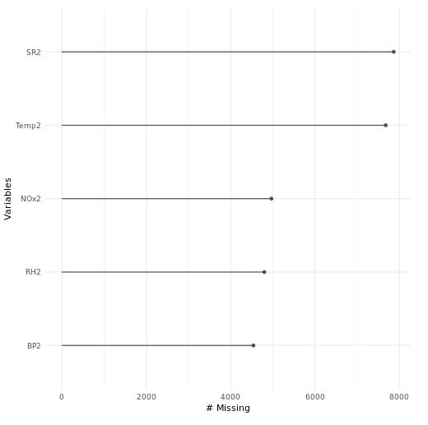
Data Processing:
Outlier Treatment
No specific treatment is done for outliers, dropped all the values below and above mean+/- 3*standard deviation.
Missing Value Replacement
No specific treatment is done for missing values, dropped all the missing values.
Splitting data
Creating test and train data at 75 and 25 ratio
Missing Value Plot:
At Kadubeesanahalli
At BTM
At Peenya
May 2019
Predicting NOx Levels

Slide 11
Data Processing(Continued):
Data Size without 60 days lag as of NOx as independent variable
Location | Dependent Variable | Independent Variable | Data size before treatment |  | Data size after treatment |  | Train dataset | Test dataset
 |  |  | observations | variables | observations | variables
BTM | log(Nox) | BP,RH,SR,Temp, VWS,WD,WS | 21006 | 8 | 4323 | 8 | 3242 | 1081
Peenya | log(Nox) | BP,RH,SR,Temp | 21360 | 5 | 9995 | 5 | 7496 | 2499
Kadubeesanahalli | log(Nox) | BP,RH,SR,Temp, VWS,WD, WS | 21126 | 8 | 575 | 8 | 431 | 144
Data Size with 60 days lag as of NOx as independent variable
Location | Dependent Variable | Independent Variable | Data size before treatment |  | Data size after treatment |  | Train dataset | Test dataset
 |  |  | observations | variables | observations | variables
BTM | log(Nox) | BP,RH,SR,Temp, VWS,WD,WS,log(Nox) | 21006 | 8 | 3869 | 9 | 2901 | 968
Peenya | log(Nox) | BP,RH,SR,Temp, log(Nox) | 21360 | 5 | 8853 | 6 | 6639 | 2214
Kadubeesanahalli | log(Nox) | BP,RH,SR,Temp, VWS,WD, WS,log(Nox) | 21126 | 8 | 453 | 9 | 339 | 114
May 2019
Predicting NOx Levels

Slide 12
Fitting and model Assessment:
Model Details:
Model Details
Sampling | Bootstrap – caret package (n = 1000 for stepwise regression)
Methods | Backward Elimination and Stepwise Regression
Validation | Loss/error on test dataset
Transformation | Log transformation of dependent variable
Model Details
Sampling | Bootstrap – caret package (n= 10 & 15)
Methods | Random forest
Validation | Loss/error on test dataset
Transformation | Log transformation of dependent variable
May 2019
Predicting NOx Levels

Slide 13
Model Assessment(Continued):
May 2019
Predicting NOx Levels

Slide 14
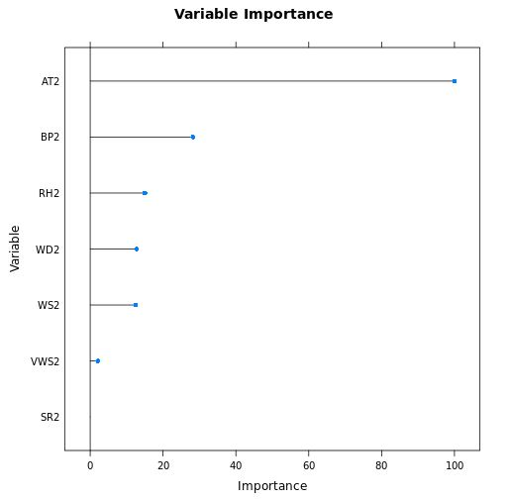
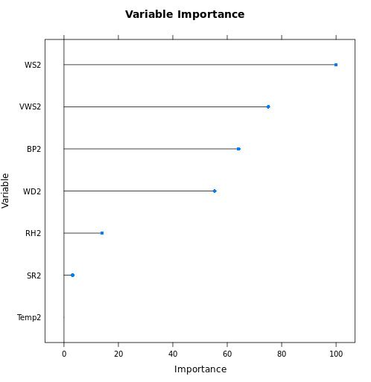
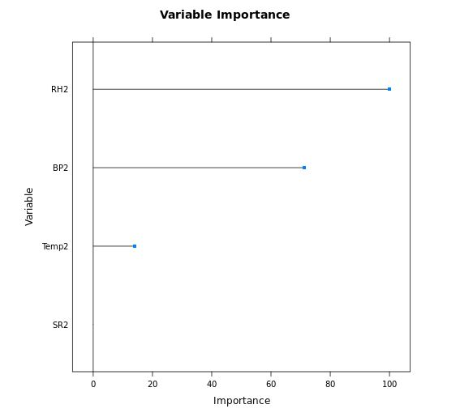
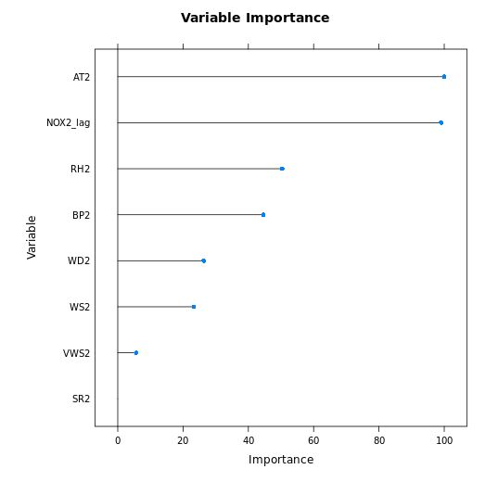
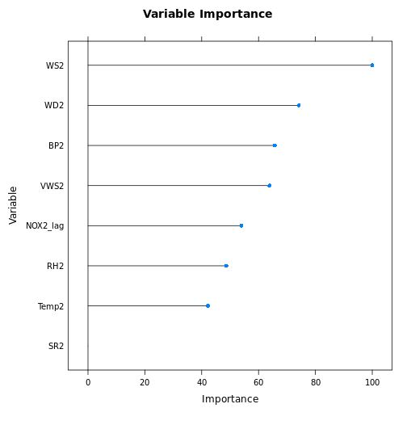
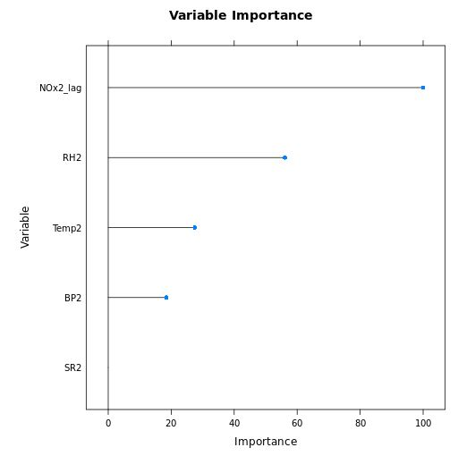
Model Interpretation:
Variable importance of random forest model for without and with lag variable:
Kadubeesanahalli
BTM
Peenya
May 2019
Predicting NOx Levels

Slide 15
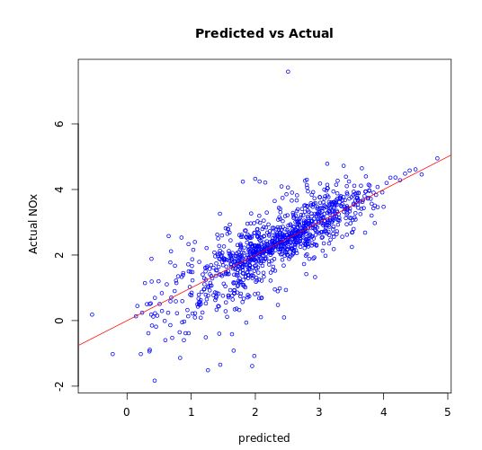
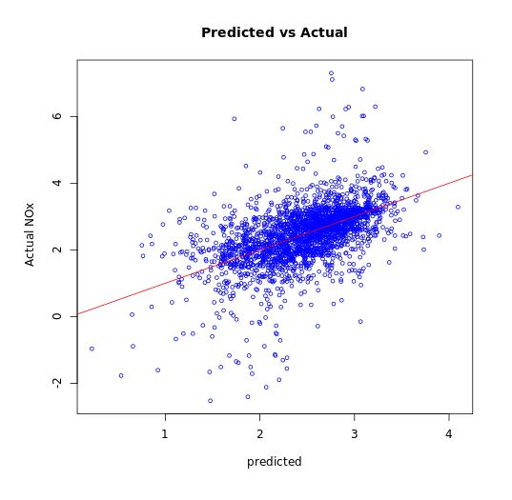
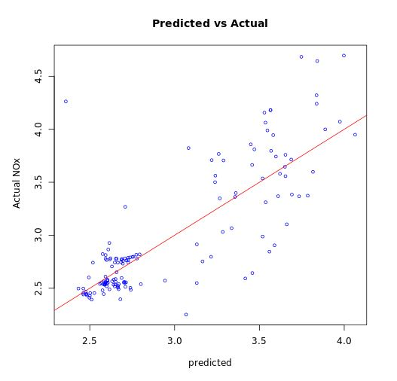
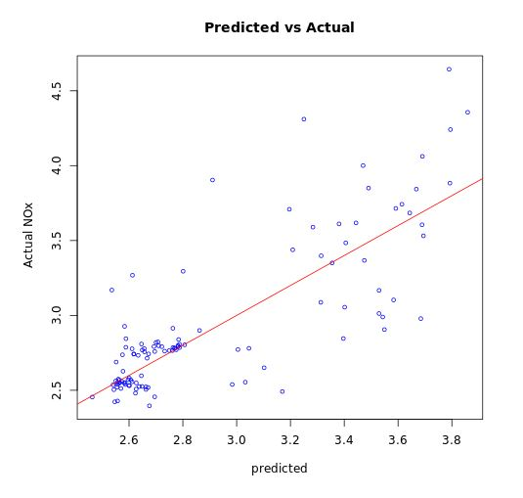
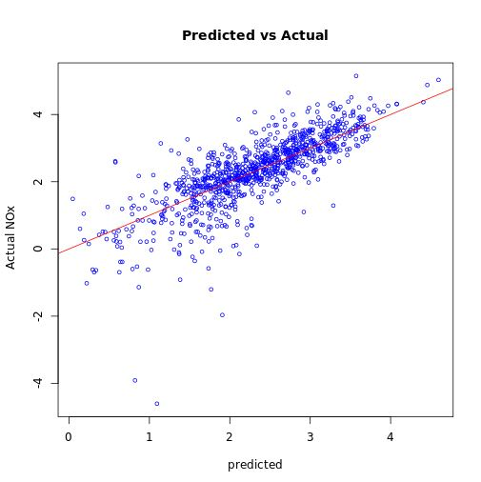
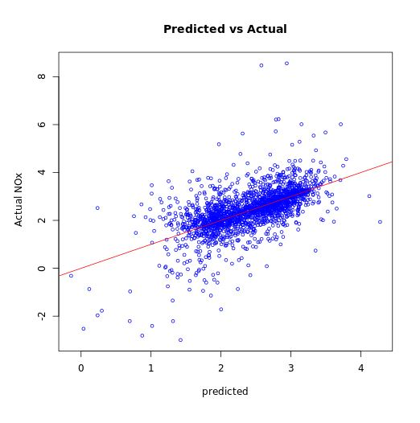
Model Interpretation(Continued):
Model fit for without and with lag variable:
Kadubeesanahalli
BTM
Peenya
May 2019
Predicting NOx Levels

Slide 16
Recommendation:
Proper maintenance of the existing monitoring device.
Should increase the number of monitoring stations.
Peak hour traffic management to reduce pollutant emission due to traffic congestion.
Framing strong policies against emission of pollutant should be based on to the particular area based on the geography of the location.
Scope for improvement:
Time Series Analysis using RNN/LSTM
May 2019
Predicting NOx Levels

Slide 17
Thank You!!
May 2019
Predicting NOx Levels

